Slide 1
DIGITAL INTEGRATED CIRCUITS • HARDWARE SECURITY
A Reliable Schmitt-Trigger-Assisted CMOS SRAM PUF Cell
with Lightweight Unstable-Bit Detection for IoT Hardware Security
Doaa Odeh (1221370) · Aseel Hamed (1231891)
Ahmad Salameh (1230737) · Anis DarHammouda (1230834)
Dept. of Electrical & Computer Engineering
AMIS C5 0.5 µm CMOS
VDD = 5 V
4×4 Array
LTspice + Electric VLSI

Slide 2
MOTIVATION
The Problem: IoT Chips Need Keys They Can Trust
Stored keys are risky
IoT nodes need a unique identity, but a secret in on-chip memory adds cost and can be read by an attacker.
A PUF generates the key instead
It derives a chip-unique key from the random transistor mismatch of fabrication — hard to clone, nothing stored.
The catch: reliability
In an SRAM PUF, near-balanced cells flip between reads, so a fraction of the key bits are unstable.
OUR QUESTION
Can a very small SRAM PUF become reliable without heavy error-correction hardware?
Our approach — two lightweight add-ons:
Schmitt-trigger readout → rejects read noise
Unstable-bit detector → masks the flaky bits
02

Slide 3
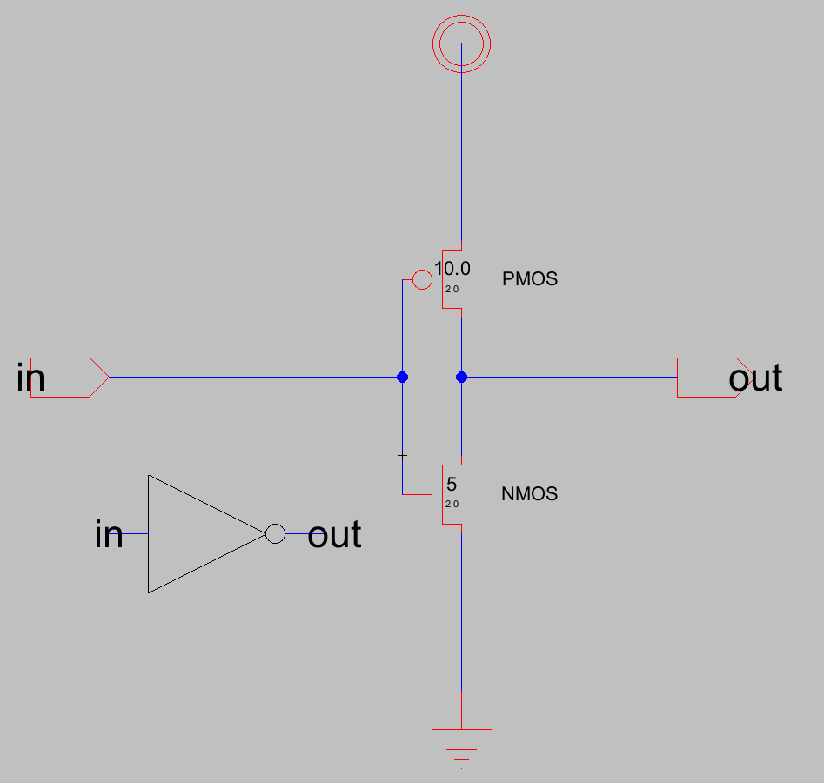
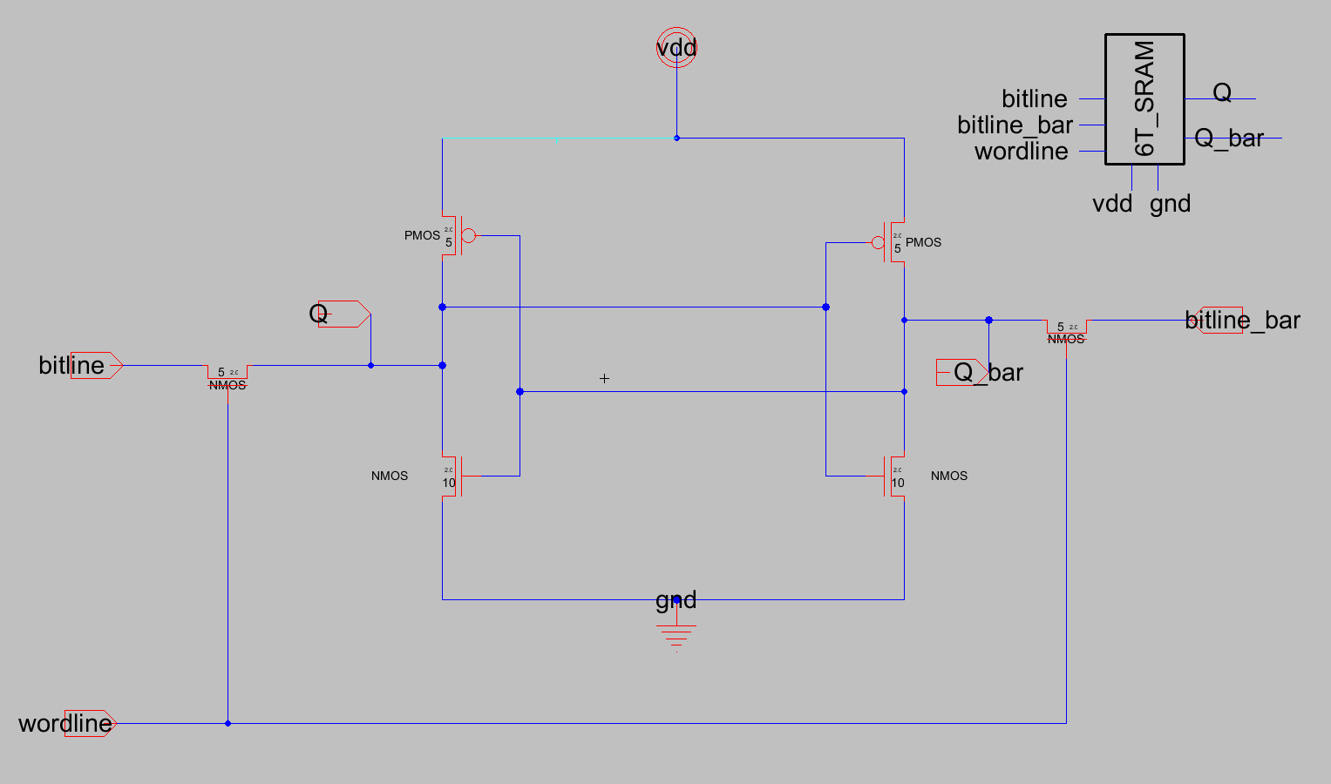
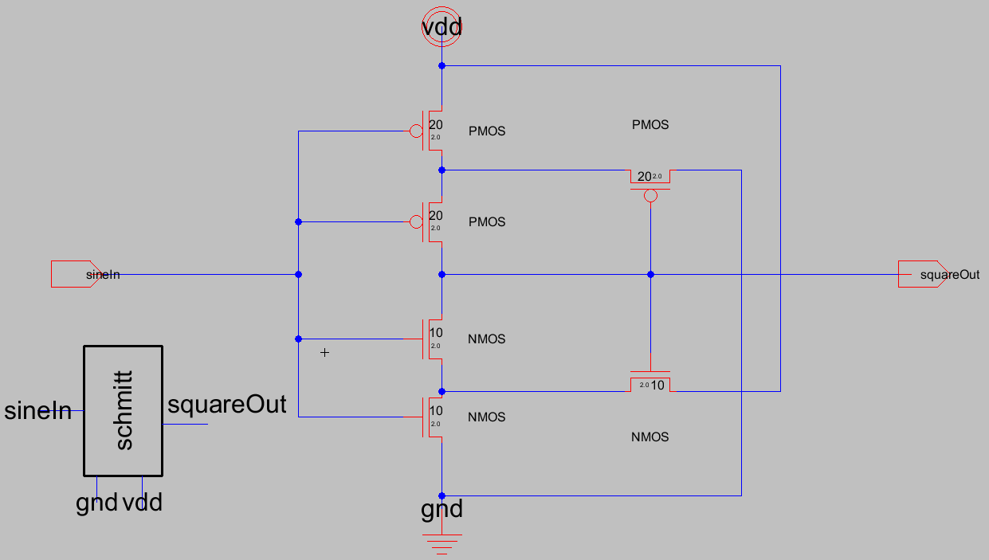
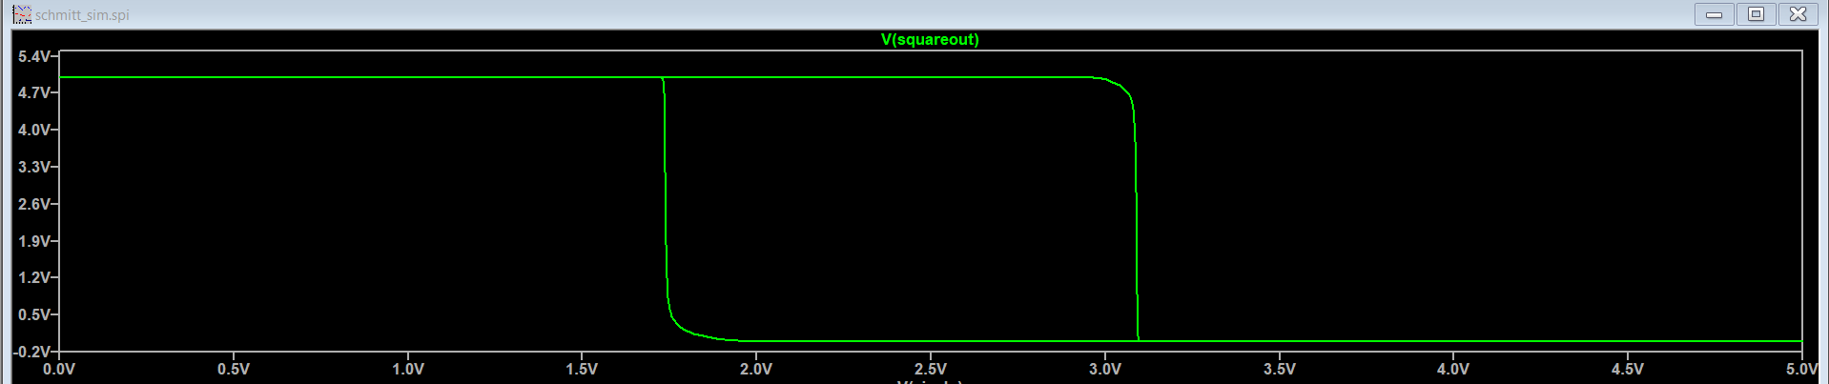
BASELINE BUILDING BLOCKS
Foundations: Inverter, 6T SRAM & Schmitt Trigger
CMOS Inverter
6T SRAM Cell
Schmitt Trigger
Simulated Schmitt-Trigger Hysteresis — transitions at ≈ 1.75 V / 3.1 V
03

Slide 4
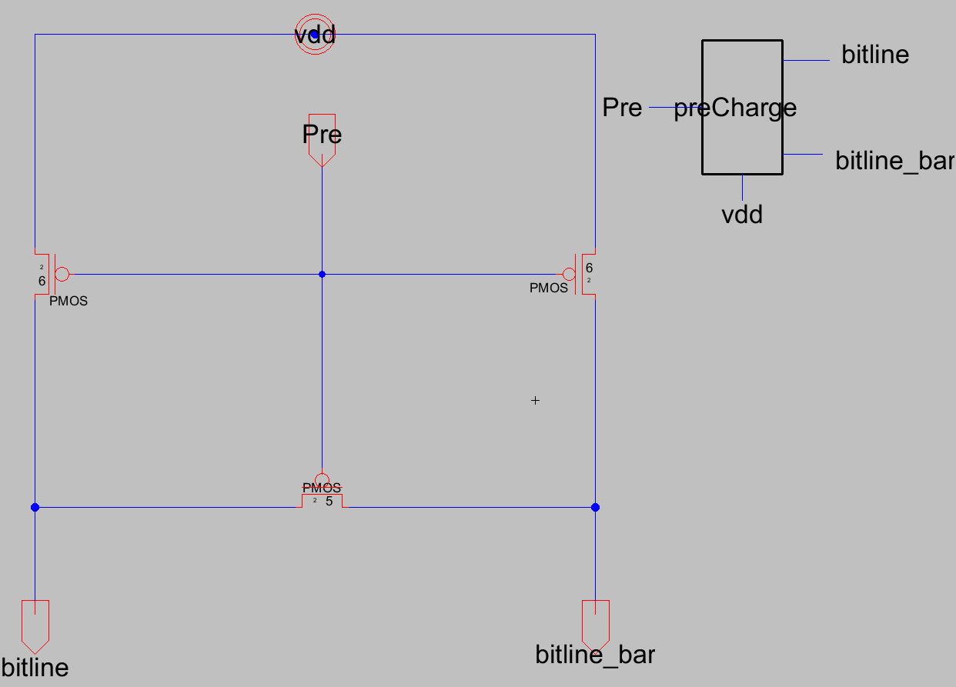
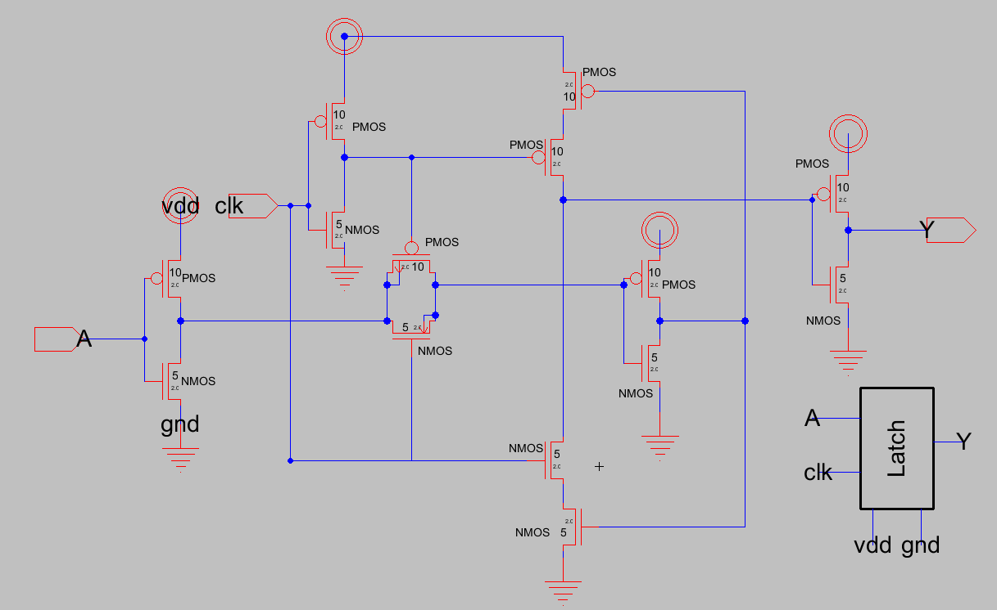
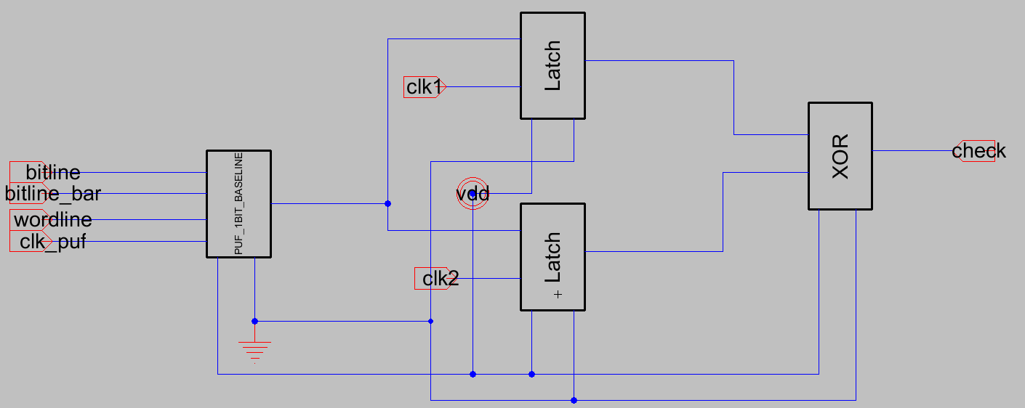
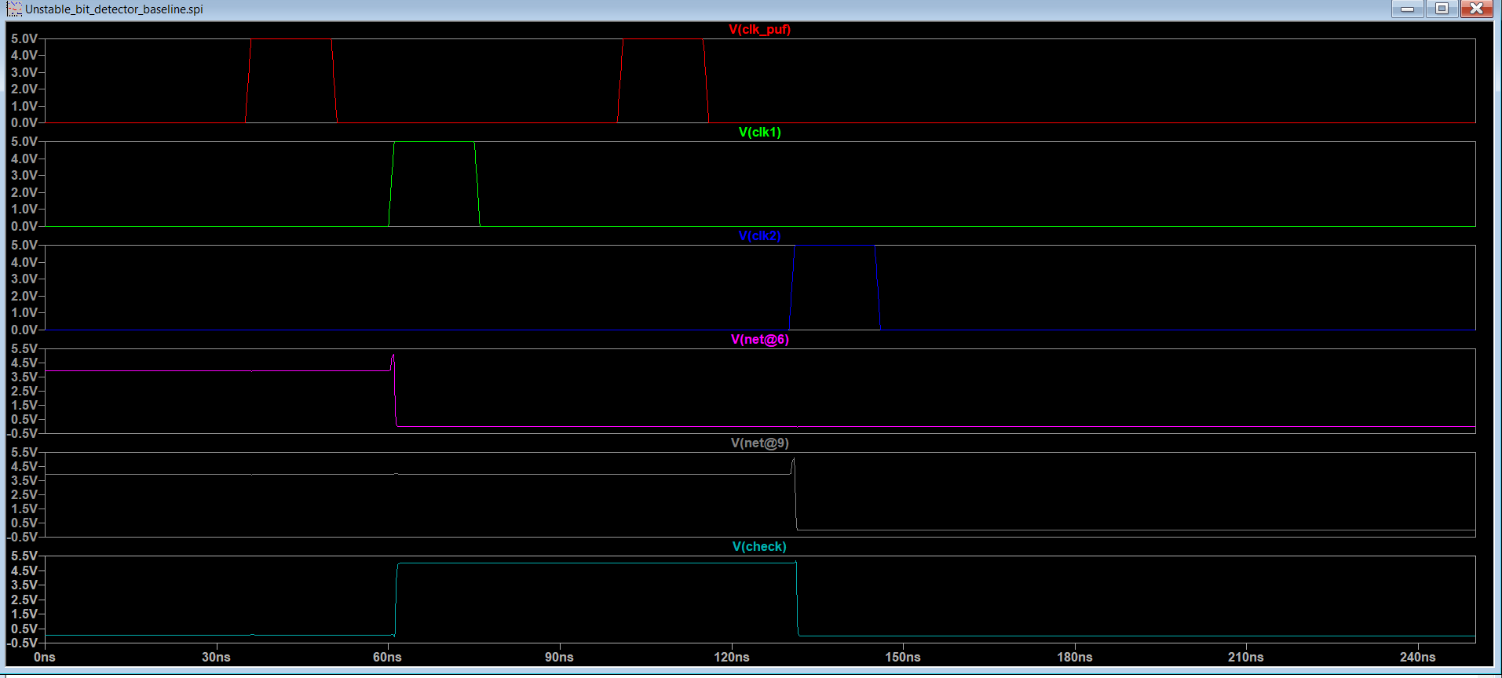
SUPPORTING BLOCKS & RELIABILITY ENGINE
Precharge, Latch & the Unstable-Bit Detector
Precharge Circuit
Output Latch
Dual-Latch + XOR Detector
Detector Waveform — check pulses high when the two samples disagree
04

Slide 5
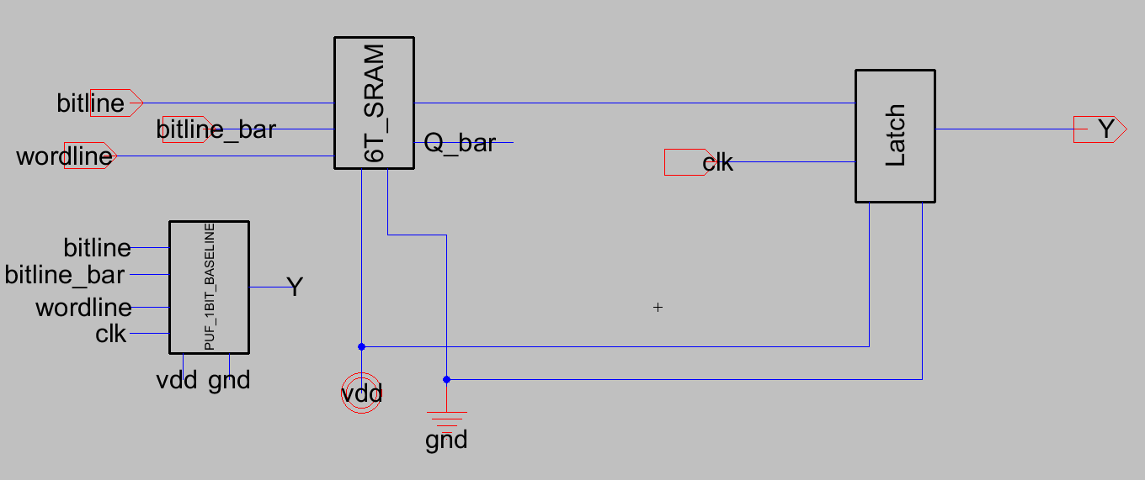
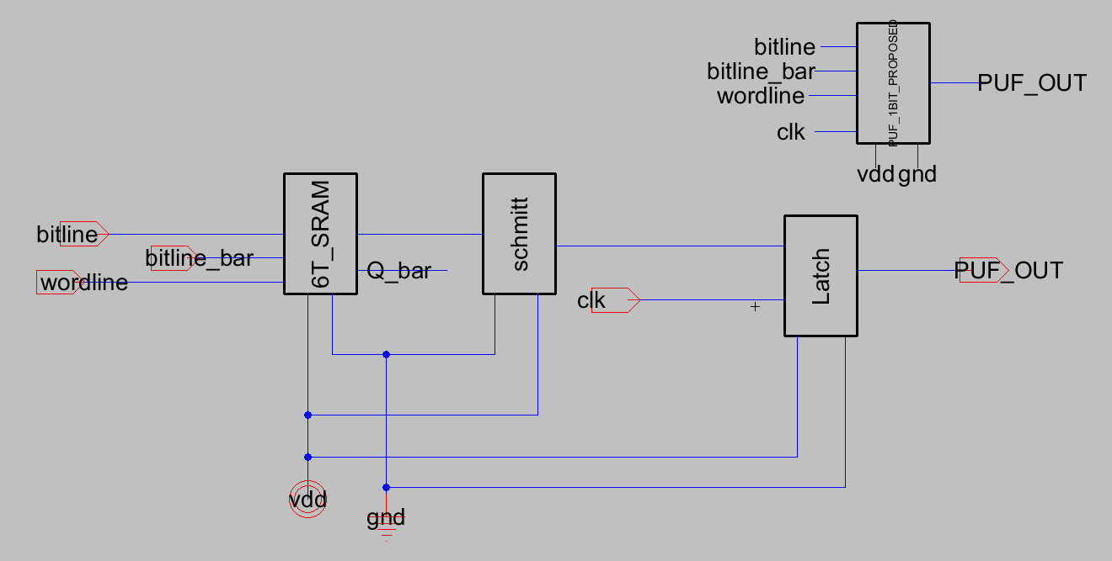
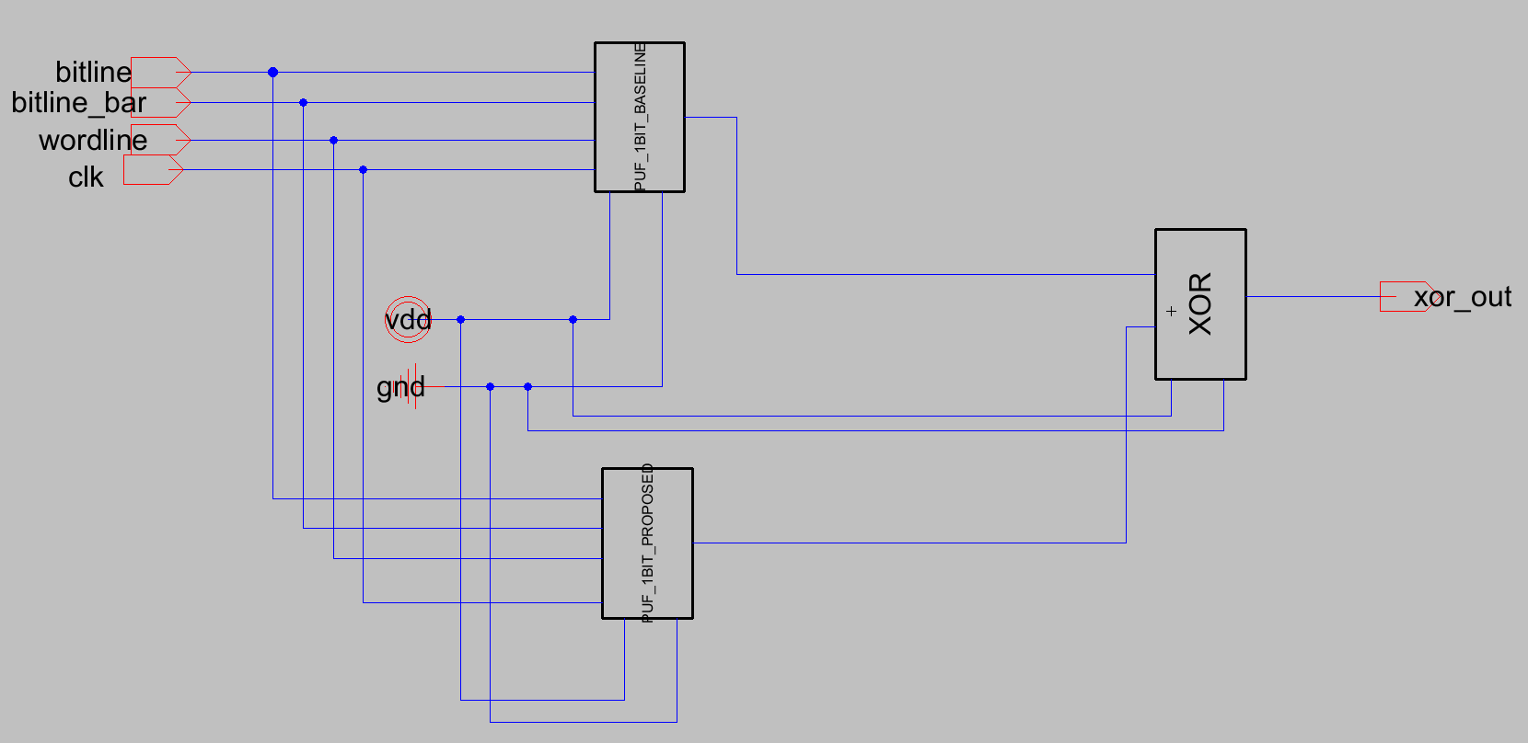
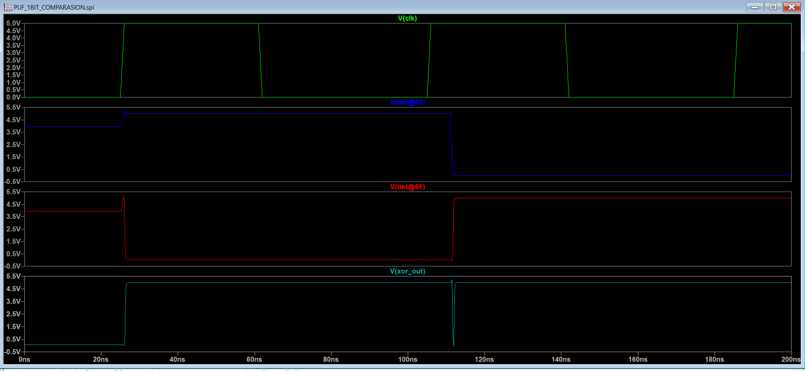
1-BIT PUF CELL
Baseline vs Proposed: Assembly & Direct Comparison
Baseline (6T + Inverter + Latch)
Proposed (6T + Schmitt + Latch)
Both + XOR Check
Comparison Waveform — baseline output, proposed output, and their XOR
05

Slide 6
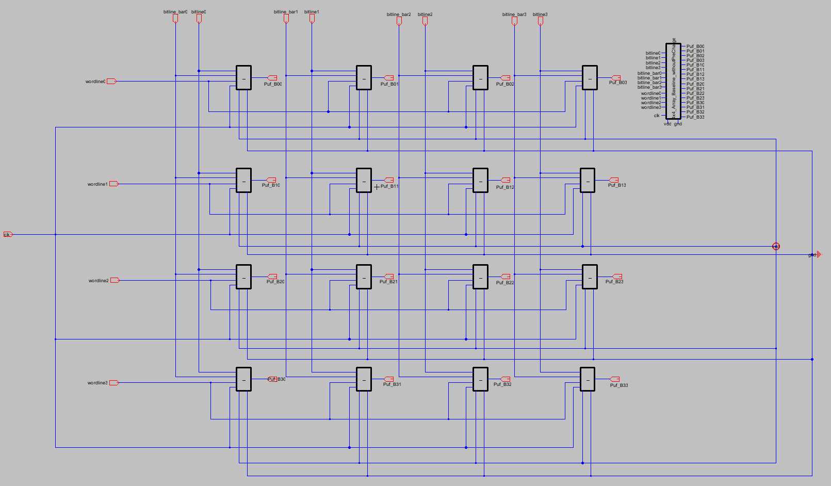
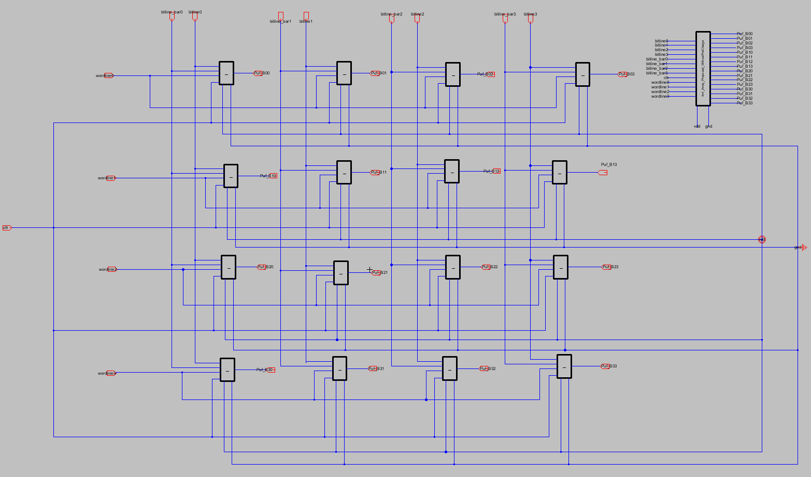
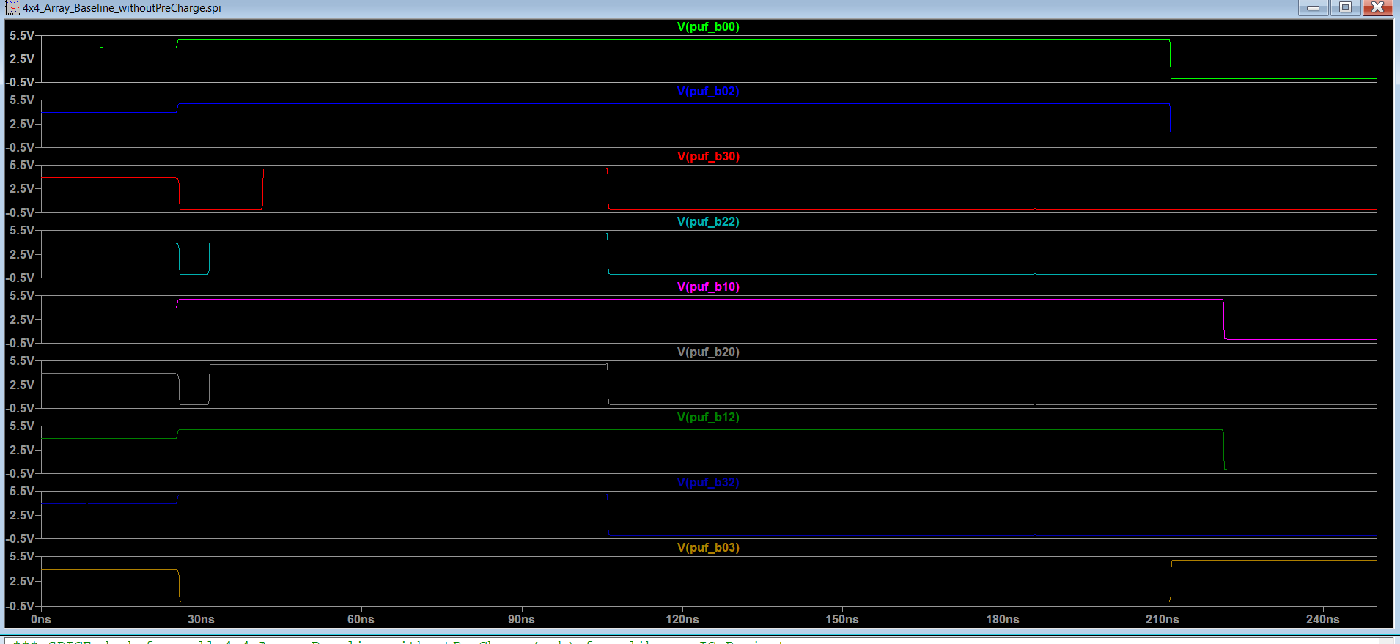
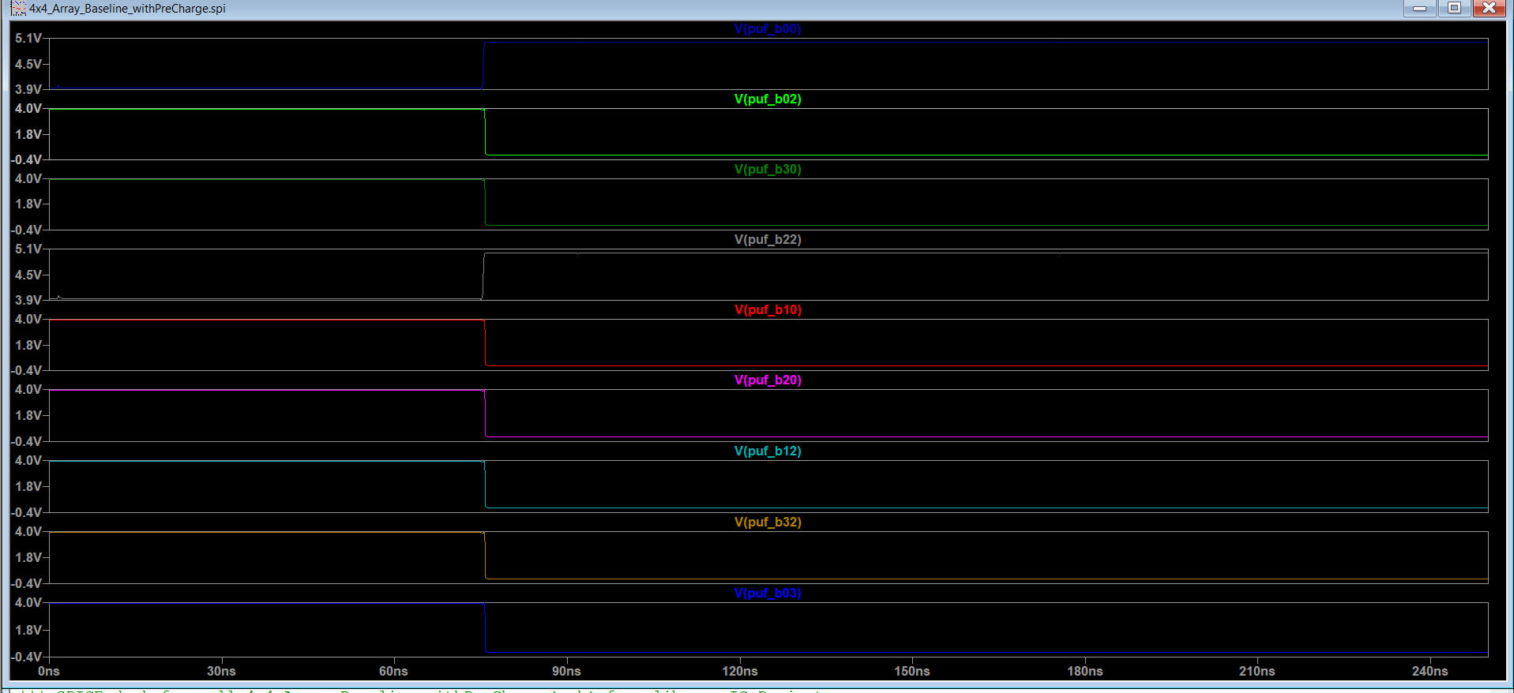
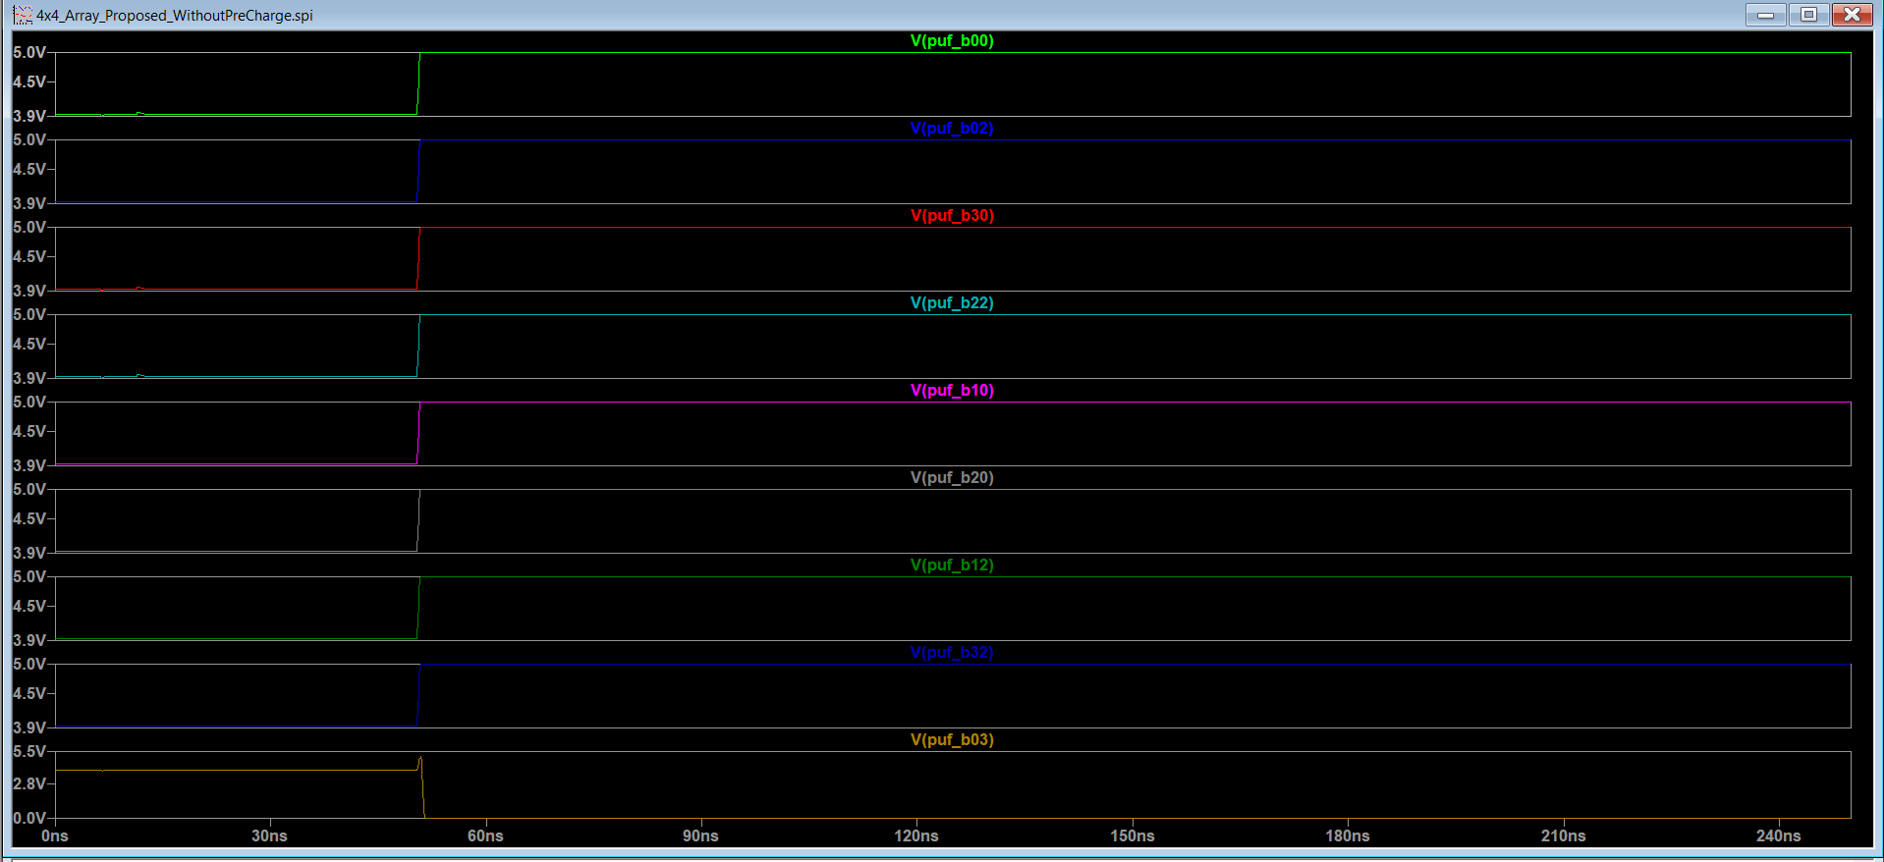
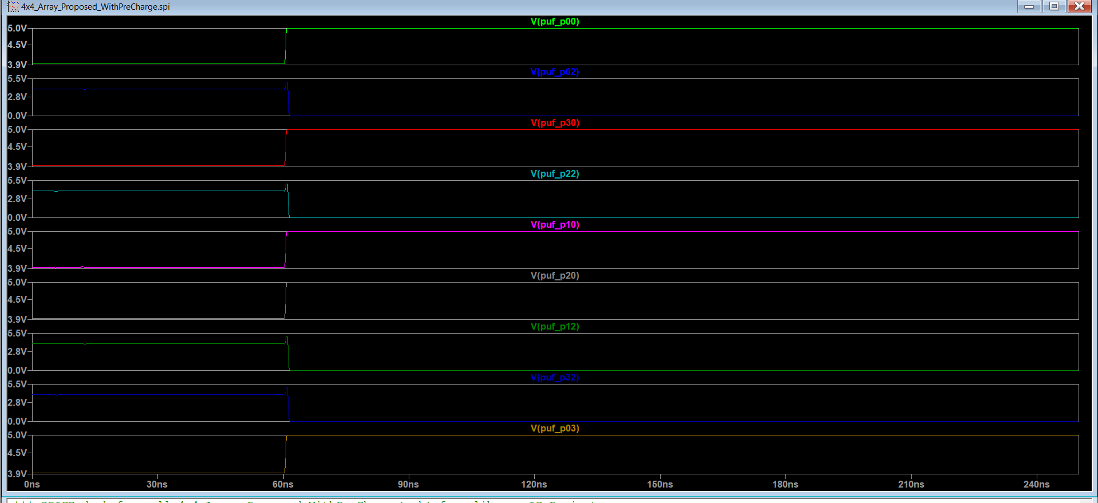
SCALING UP & DESIGN DECISION
From 1 Bit to 16: the 4×4 Array
Baseline 4×4 Array
Proposed 4×4 Array
Baseline, no PC
Baseline, w/ PC
Proposed, no PC
Proposed, w/ PC
Precharge makes each read clean but does not create the bit — the fingerprint comes from power-up mismatch, so all metrics use no-precharge mode. At the array level, 16 parallel XOR comparators (one per bit) flag exactly where the two 16-bit responses disagree.
06

Slide 7
METHODOLOGY
How We Measured It
Tools & process Captured in Electric VLSI, simulated in LTspice XVII — AMIS C5 0.5µm BSIM3 models, VDD = 5 V.
1
Fingerprint generation Supply ramped 0→5 V with access transistors off; each cell resolves by its own mismatch (power-up, no precharge).
2
Mismatch injection BSIM3 has no delvto in LTspice → a small series gate-offset source per transistor, Gaussian σ = 9 mV (Pelgrom).
3
Monte-Carlo across chips Offsets re-drawn every run to emulate independent chips (60 instances for the 4×4 array).
4
Reliability test 32 cells read 30× with independent 5 mV read noise; reads split into enroll (mask) + independent eval.
5
07

Slide 8
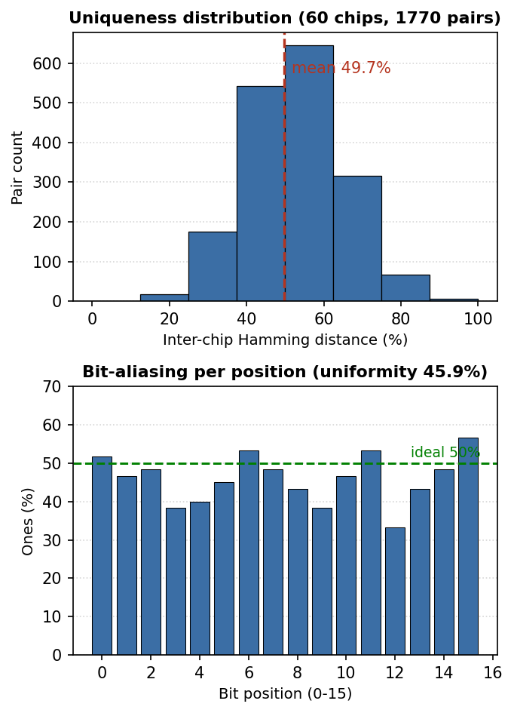
RESULTS
Results 1 — The Key Is Random & Unique
49.8%
45.9%
Uniqueness
Uniformity
inter-chip Hamming dist. (ideal 50%)
share of ones (ideal 50%)
Both metrics are close to the ideal 50% — the fingerprint is well-balanced (uniformity) and distinct from chip to chip (uniqueness). This is exactly what a good PUF needs: an unpredictable, chip-specific key.
Fig. Uniqueness distribution (60 chips) and per-position bit-aliasing
Both metrics come from the shared 6T core, so baseline and proposed are identical.
08

Slide 9
RESULTS
Results 2 — Reliability: the Headline Result
~10× fewer errors
Baseline: 15.0% BER (85.0% reliable) on independent noisy reads.
The detector masks the 59% of cells unstable at enrollment.
Retained key: 1.5% BER (98.5% reliable) on an independent evaluation set.
Trade-off: a shorter key — same reliability-for-length deal as the ASCH-PUF reference.
09

Slide 10
COMPARISON
Baseline vs Proposed — What It Costs
Metric | Baseline | Proposed | Note
Uniqueness (inter-chip HD) | 49.8% | 49.8% | shared core
Uniformity (% ones) | 45.9% | 45.9% | shared core
Bit-error rate (with read noise) | 15.0% | 1.5% | detector masking
Reliability | 85.0% | 98.5% | on retained bits
Idle power (1-bit) | 75.6 pW | 216 pW | gated readout
Read energy (1-bit) | ≈ 0 | 6.56 pJ / read | gated Schmitt+latch
Readout delay (10 fF) | ~54 ps | ~101 ps | ~1.9×
Cell area (1-bit) | 5,595 µm² | 7,339 µm² | +31%
4×4 array area (layout) | 160,921 µm² | 244,455 µm² | +52%
Uniqueness & uniformity come from the shared 6T core; the proposed cell pays area, power, energy and delay to buy the reliability gain.
10

Slide 11
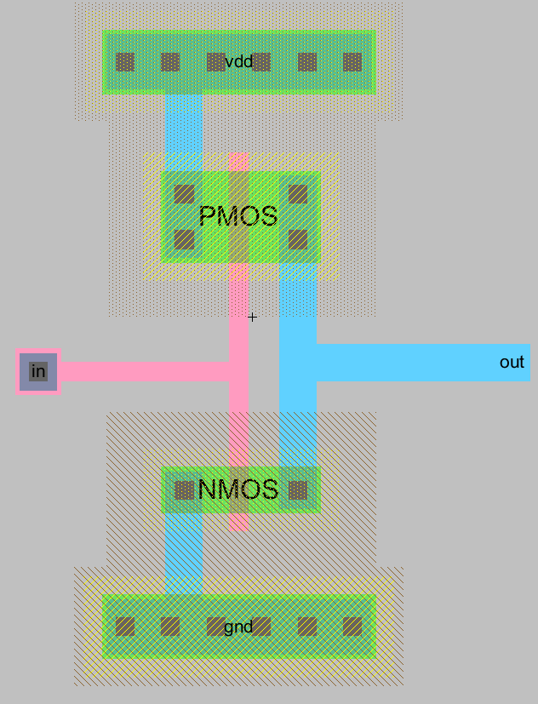
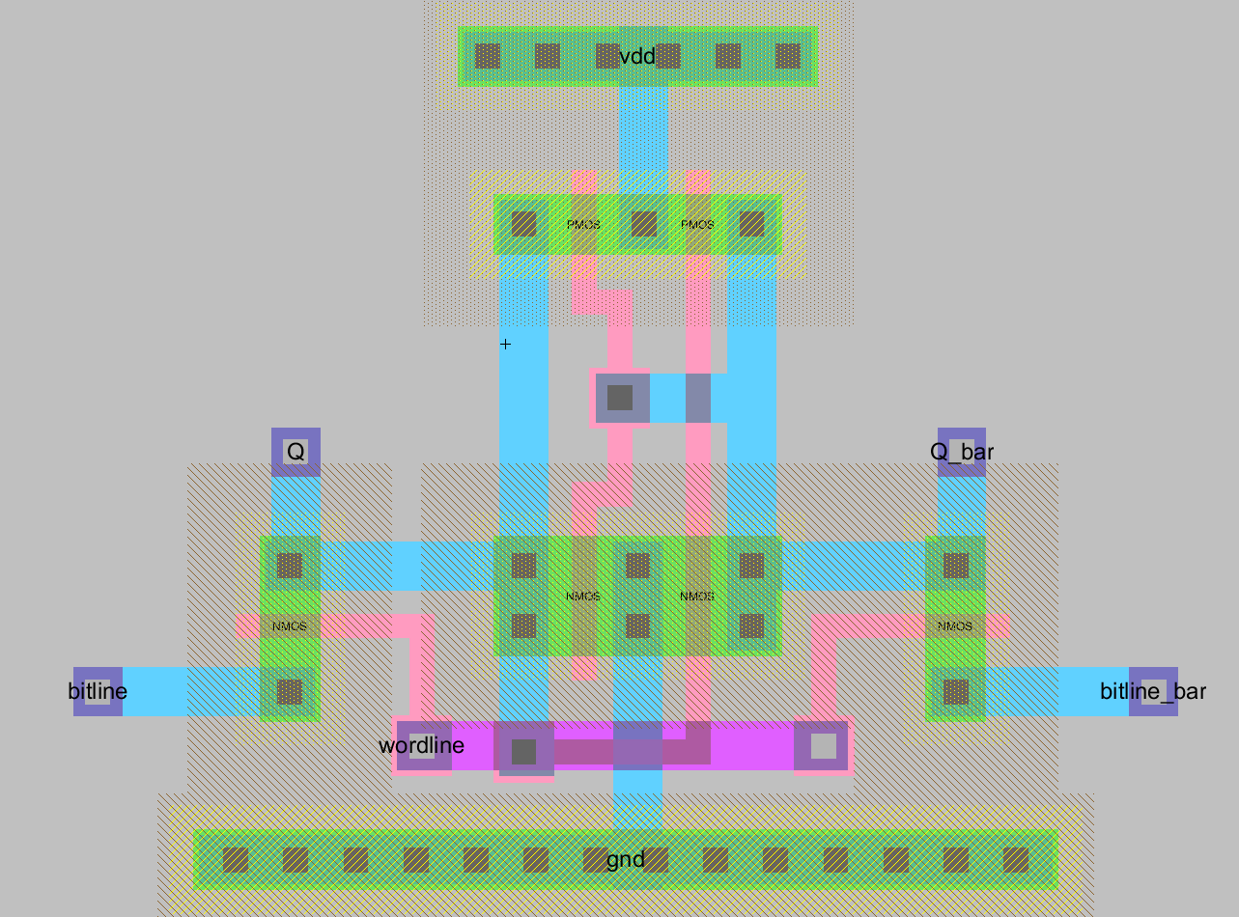
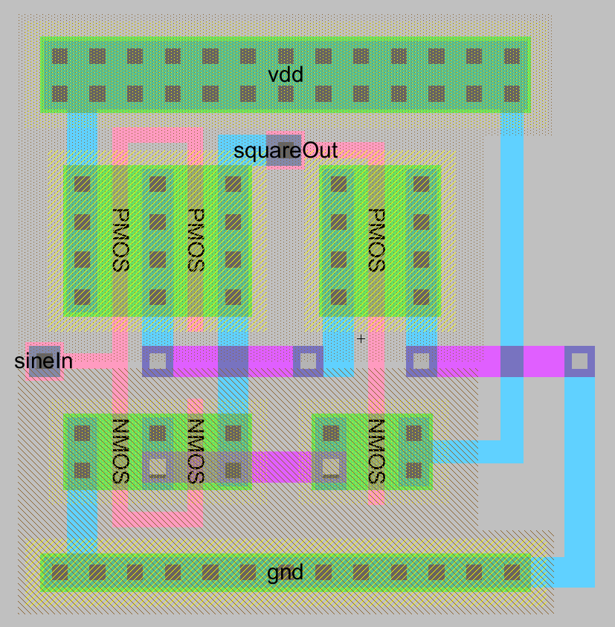
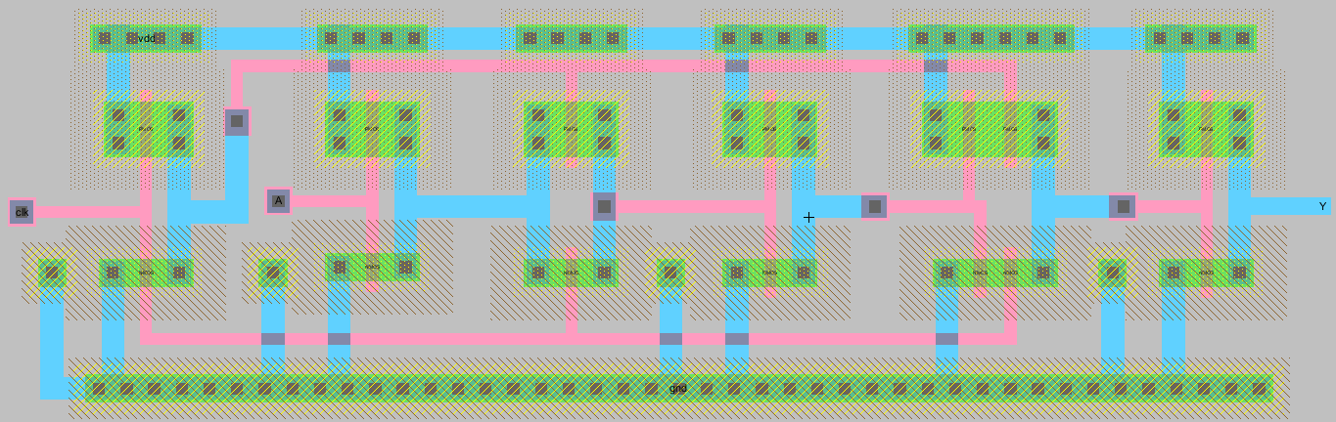
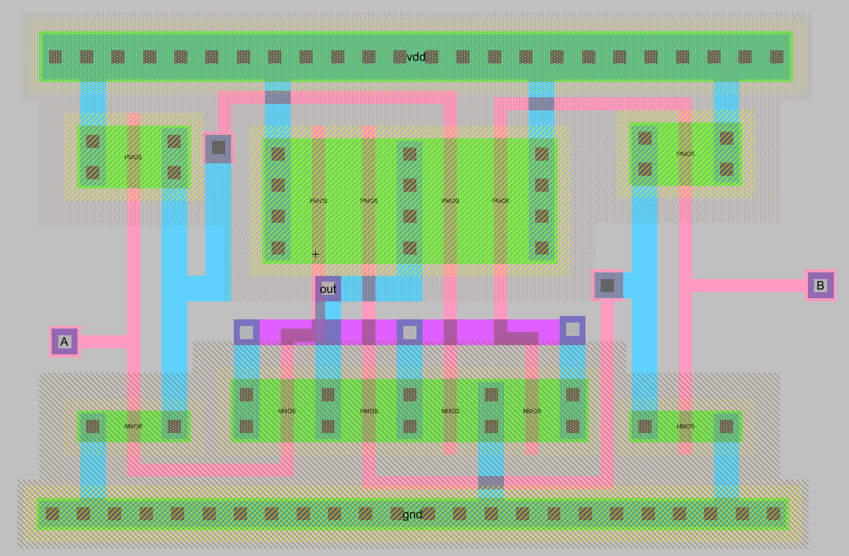
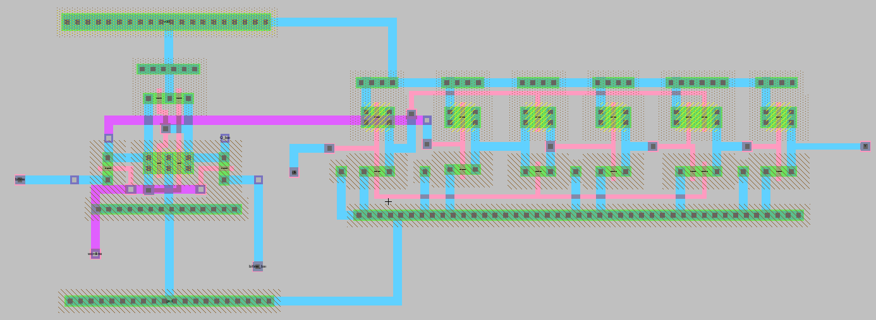
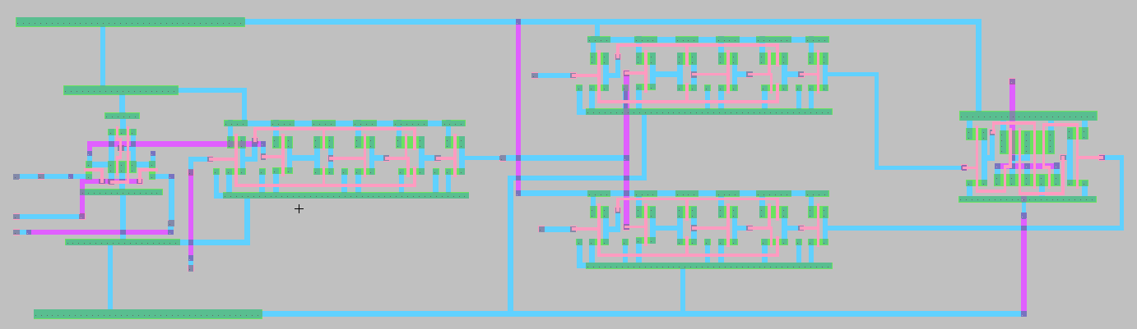
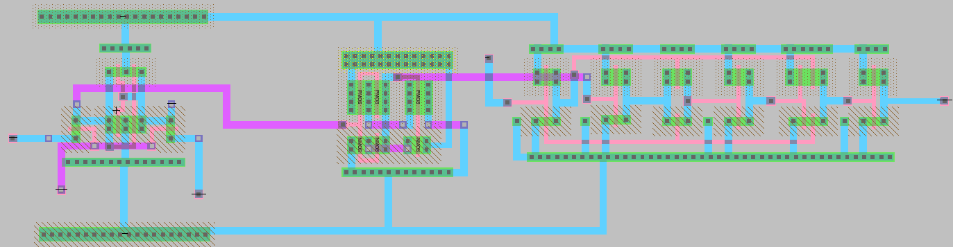
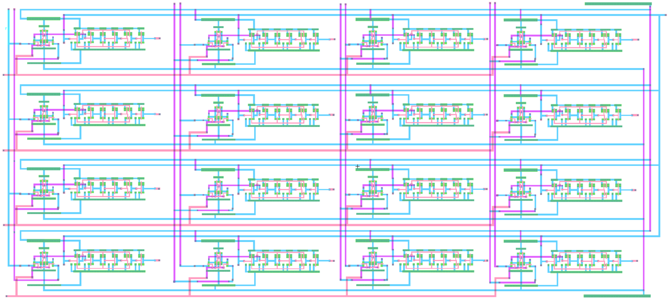
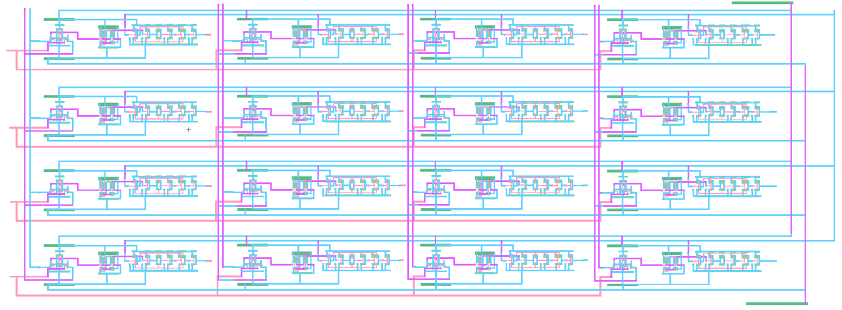
PHYSICAL DESIGN
Layout & Verification — Every Block
Inverter
6T SRAM
Schmitt
Latch
XOR
Detector
PUF Baseline
PUF Proposed
Array Baseline
Array Proposed
All 10 implemented cells and arrays are DRC-clean and NCC-matched to schematic.
11

Slide 12
CONCLUSION
A tiny SRAM PUF made reliable — without heavy error correction
15% → 1.5%
≈ 50%
DRC / NCC
~10× lower bit-error rate from lightweight unstable-bit masking
Near-ideal uniqueness (49.8%) and uniformity (45.9%)
Every cell laid out clean and matched to schematic
Honest scope: all electrical results are schematic-level (no parasitic extraction); reliability via repeated-read noise; array driven by stimulus, not a decoder.
Future work: post-layout extraction, temperature & voltage sweeps, decoder-addressed compact array, a crowbar-free low-power readout, and formal randomness testing.

